Slide 1
Ad A/B Test

Slide 2
Executive Summary
The current Ad should be replaced with Ad C
Ad C has approximately 700 more clicks compared to the current Ad
There is a statistical significance between the means of the current Ad and Ad C

Slide 3
There is a statistically significant difference in means between the Current Ad and Ad C
95% accuracy when p-value falls below the alpha

Slide 4
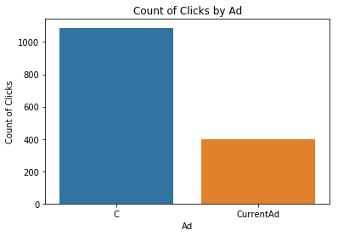
A significant amount of users favor Ad C over the current Ad
Approx. 700 click difference

Slide 5
User feedback that is affecting the ad click rate
Poor communication about the product
Unaware of capabilities
Not enough time to complete
“I wasn’t aware of Ready features.”
“I have a hard time understanding how I’d be billed, so I didn’t want to give my credit card information.”
“I’m really interested in the Ready and Pro features, but I’ve paid for them before and never used them. I didn’t feel like I was getting my money’s worth.”
“I’m a Ready user. I love the projects! I wish I had more time to make progress. It’s hard to balance my course workload and time for individual projects.”
Notes:
Confounding variables important to consider would be employment status, time of year, or hours at work

Slide 6
Take into consideration confounding variables
Unemployed users may not want to pay for premium offers
Users in school who may not have time to use Codecademy
These users may want to use the product during extended breaks
Full-time workers may not have the energy to learn on the platform

Slide 7
Next Steps
Use the confounding variables as marketing strategies
Test the other ads to determine if they would return more clicks
Identify the users who purchase the product after clicking

